Slide 1
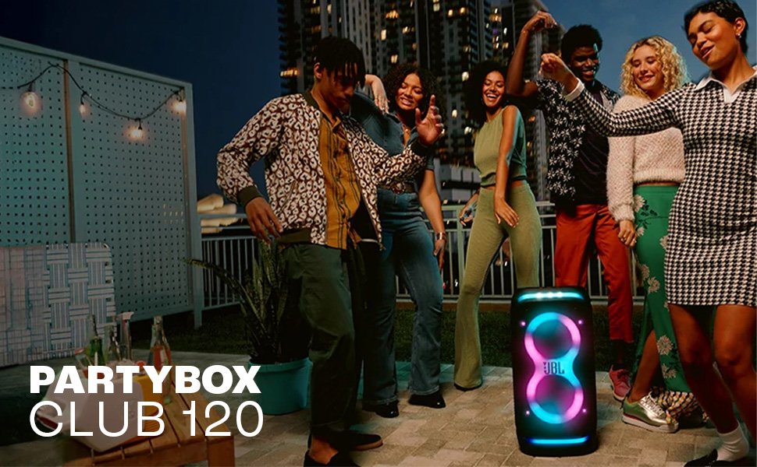
JBL Partybox Club 120 : Amazon Analysis
Group 2
Name | Roll Number
Somtirtha Pal | P2522072
Shrijita Das | P2521070
Suvayan Dey | P2522076
Souparno Karmakar | P2521074
Utsav Banerjee | P2521085
Mayank Somnathe | P2521048
Shahil Verma | P2522061
Anirudha Nath | P2522007
Prateek Kushwaha | P2521058
Apurva Badola | P2522011
Subhadeep Sinha | P2521078
M Praveen Kumar | P2522036
Karan Kamath | P2522029
Dhruv Mathur | P2521034
Anusha Agarwal | P2522009
Ananth Papewar | P2522005

Slide 2
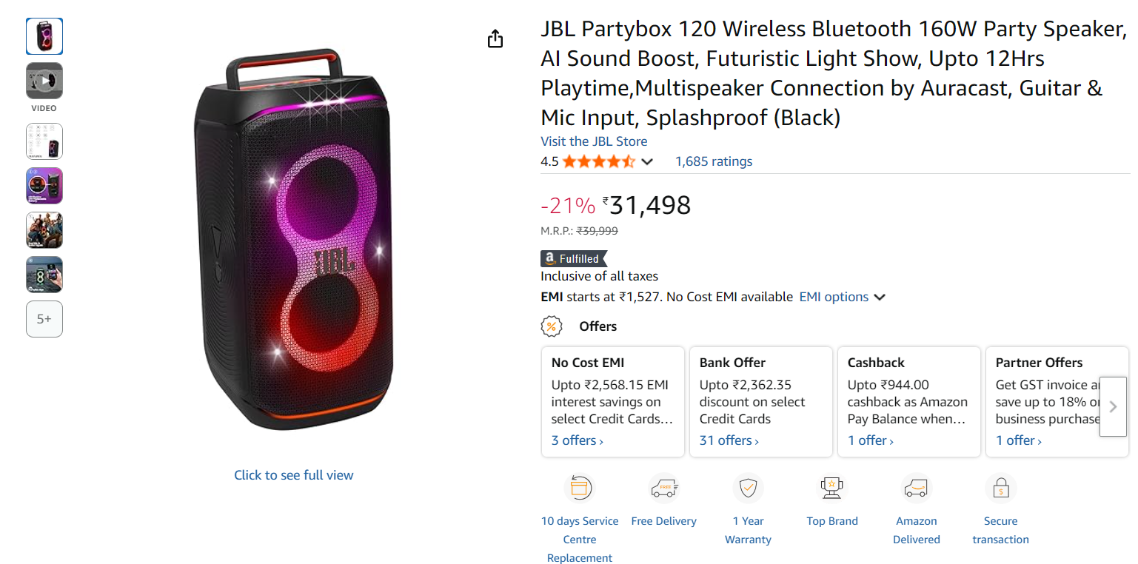
JBL Partybox 120
Key Specifications
160W Portable Party Speaker
Futuristic Light Show
Auracast multi-speaker connection
Dual Mic & Guitar inputs
AI Sound Boost Technology
Up to 12 hrs playtime
IPX4 splashproof design

Slide 3
Product Listing Analysis
What The Listing Does Well
Title clarity: Includes model + power + key hooks (AI Sound Boost, Light Show)
Rich media: Multiple product images + lifestyle visuals; videos available in many regions
Badges/Trust: Amazon's Choice (where applicable), Fulfilled by Amazon, clear warranty info
Feature bullets: Highlights 160W output, 12h battery, IPX4 rating, Auracast, mic/guitar inputs
Gaps & Opportunities
Title SEO: Missing "Bluetooth 5.3", "Portable Party Speaker", "Bass", "JBL Pro Sound" upfront
Bullet specificity: Lacks quantified claims (battery at 50% volume, charging time, driver sizes)
A+ Content: Missing comparison chart vs PartyBox 110/320 and Sony XV500; no use-cases shown
Q&A/Images: Need common queries answered; missing rear I/O close-ups and app screenshots

Slide 4
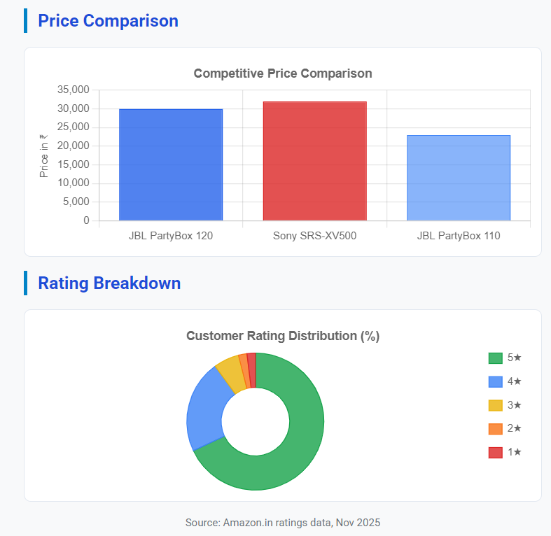
Reviews & Pricing Analysis
Customer Sentiment
Overall Rating: 4.5/5 (1,600+ ratings)
Pros mentioned frequently:
Powerful JBL Pro Sound & deep bass performance
Impressive light show enhances party atmosphere
Portable design with foldable handle for easy transport
App control & Auracast connection highly praised
Cons mentioned frequently:
Battery life varies significantly at high volume settings
Bass expectations vary depending on room size
Weight (5.5 kg) can be cumbersome for extended carrying
Market Positioning
Current price: ₹31,498 (MRP: ₹39,999 - 21% discount)
Sale history: Observed dips to ₹24,999-₹29,899 during festival events
Value perception: Significantly improves at price points ≤₹26,000
68%
22%
6%
2%
2%

Slide 5
Recommendations: Boost CTR & Conversion
SEO Copywriting
Title Optimization: "JBL PartyBox Club 120, 160W Portable Bluetooth 5.3 Party Speaker, AI Sound Boost, 12H Battery, IPX4, Auracast, Dual Mic & Guitar, Light Show“
Enhanced Bullets: Add measurable details (driver sizes, charging time, latency, app features) and specific use-cases
Reviews & Q&A
Review Generation: Enroll in Amazon Vine / implement post-purchase emails to drive high-quality reviews
FAQ Management: Seed/answer FAQs on Auracast linking, karaoke latency, charging while playing, app controls
Creative Assets
Video Demo: Add 30-45s demo in first position showing light effects, sound quality, and portability
A+ Content: Create comparison table vs Sony XV500 & JBL PB110; show party scenarios and accessory bundles
Ads & Traffic
Ad Targeting: Sponsored Brands Video + Sponsored Products on keywords: "party speaker 160W", "Sony XV500", "JBL partybox"

